Slide 1
UNIT II

Slide 2
SELECTING A MODEL
Raw data – representation – summarized / structured – meaningful insight – MODEL
Decision regarding model selection – learning task – problem to be solved & type of data
Prediction – target field numeric and continues – regression model is assigned
Process of assigning a model, fitting a specific model to a data set – Model Training

Slide 3
In ML paradigm – potential causes of disturbance , eg-in finding terrorist for proposed attack - weapon sales, inflow of immigrants, avg income of local population – are the input variables
Called as predictors, attributes, features, independent variables / variables
Input variables – X ; Output Variable - Y
X₁, X₂, X₃,….. X_{n –} individual input variables
General representation
Y = f(X) + e ;
‘f’ is the target function; ‘e’ is the error term

Slide 4
Frequently tracked functions –
Cost function – Error function – measures the extent to which the model is going wrong in estimating the relationship between X and Y ; how bad model is performing
Loss function – almost similar to cost function - defined on data point; while cost function is for entire training data set
Objective function – ML is optimization problem – way to evaluate the quality or optimality of a solution – objective is goal
Target is to find values of model parameter to max or minimize the return value

Slide 5
Multiple factors - selecting the model
Kind of problem we want to solve
The nature of underlying data
Model – yielding remarkable results in certain situations may fail in different situation
Difficult to give a generic guidance related to which ML has to be selected
No one model that works best for every ML Problem
As in ‘ NO FREE LUNCH’
Two types
Models for supervised learning – predictive models
Models for unsupervised learning – Descriptive models

Slide 6
Predictive Models
Try to predict certain value using values in i/p data set
Learning model – establish relationship b/w targe feature , i.e, feature being predicted and the predictor features
Clear focus on – what to learn & how to learn
Predict value of category or class
Predicting win/loss in a cricket match
Predicting whether a customer may move to another product
Algos used – kNN, Decision Tree etc
Predict numerical values of the target
Predicting revenue growth in the successive year
Predicting amount of rainfall
Algos used – egs linear regression / logistic regression

Slide 7
Descriptive Models
Describe a data set or gain insight from a data set
No target feature or Single feature of interest
Group together similar data instances
Customer grouping or segmentation based on social, demographic, ethnic etc factors
Grouping of commodities in an inventory
Grouping of music based on different aspects
Used for Market basket analysis

Slide 8
TRAINING THE MODEL (for supervised learning)
Holdout Method
Supervised learning – using labelled input data
Test data may not be known; label value of test data not known
Part of input data is held back – holdout method
70% - 80%
Training Data
Input Data
Test Data
Model performance
20%-30%

Slide 9
- Cont..
K – fold Cross- validation method
Special variant of holdout method – repeated holdout – ensure randomness of the composed data sets
The process of repeated holdouts – basis of k-fold
The data set is divided into k-completely distinct or non overlapping random partition called folds
The value k – can be set to any number
Two popular approaches
10 fold cross-validation (10-fold CV)
Leave-one-out Cross-validation(LOOCV)

Slide 10
- Cont..
Training Data
Training data
Combined (K-1) folds
Trained Model
Test data
Test data
Model performance
Input data Set
K Folds data Set
Overall approach for k-fold cross validation

Slide 11
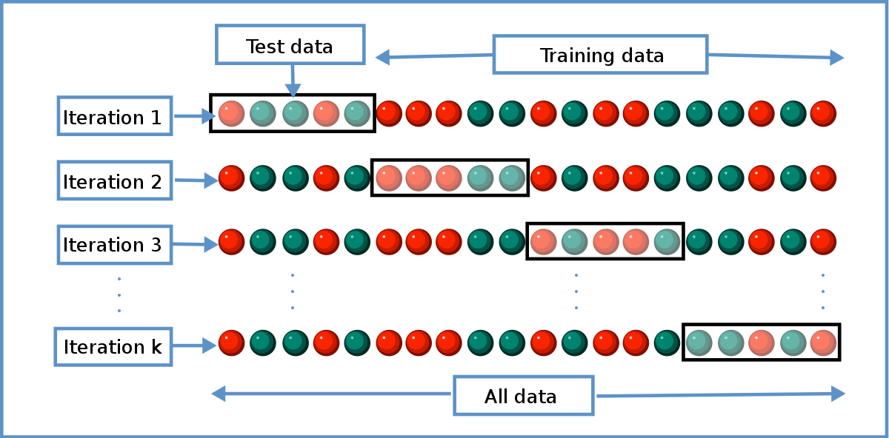
- Cont..
Detailed Approach for fold Selection

Slide 12
- Cont..
Bootstrap Sampling
Popular way of identifying training and test data from input data set
Randomly picks up instances from the data set – probability of the same data being picked repeated times
Simple Random Sampling with Replacement
Sampling theory for drawing samples
Useful when input data set is small in size

Slide 13
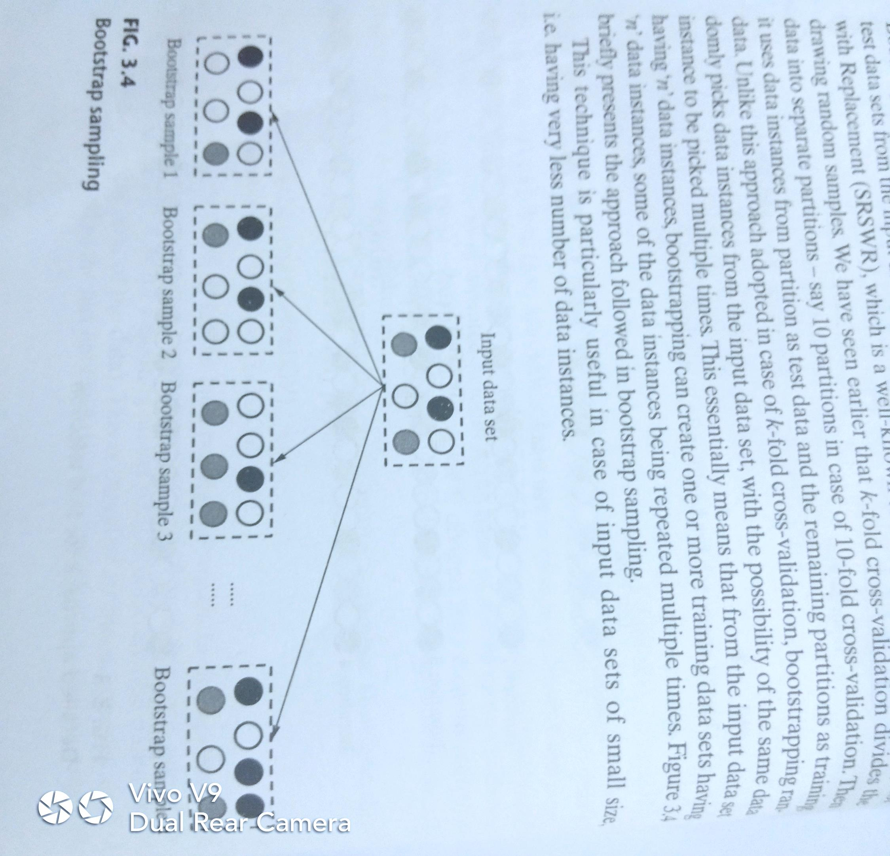
- Cont..

Slide 14
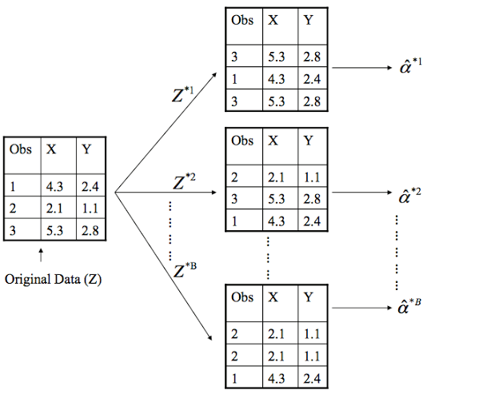
- Cont..
Example - Bootstrapping

Slide 15
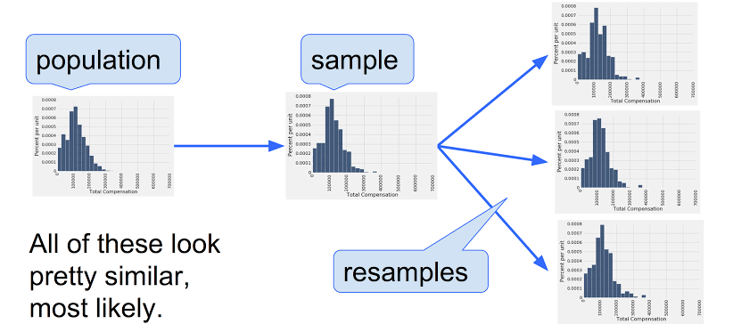
- Cont..
Example - Bootstrapping

Slide 16
Lazy Vs. Eager Learner
Eager learning follows general principals of ML
Tries to construct generalized, input depended target function during model training phase
Typical steps – abstraction and generalization – trained model
When test data comes in – mode is ready – doesn’t refer back to training data
Takes more time in learning phase than lazy learners
Lazy learning – skips abstraction and generalization process, doesn’t learn anything
Uses training data in exact, uses the knowledge to classify the unlabeled test data
Known as instance learning – depends on training data instance
Most popular is k-nearest neighbor

Slide 17
MODEL REPRESENTATION & INTERPRETABILITY
Fitness of a target function approximated by learning algorithm determines how correctly – able to classify data set never seen
Underfitting
Target function kept too simple – may not capture the essential nuances & represent underlying data
May occur when trying to represent non-linear data with a linear model
May happen due to unavailability of training data
Results in poor performance and poor generalization to test data
Avoided by
Using more training data set
Reducing feature by effective feature selection

Slide 18
Cont..
Over-fitting
Model emulates the training data too closely
Specific deviations in training data – noise or outliers, gets embedded in the model
Adversely impacts the performance of the model
Occurs – as a result of trying to fit excessively complex model to closely match training data
Results in good performance with training data set, but and poor generalization and poor performance to test data
Avoided by
Using re-sampling techniques like k-fold cross validation
Hold back of a validation data set
Remove nodes – having little/no predictive power for the ML problem

Slide 19
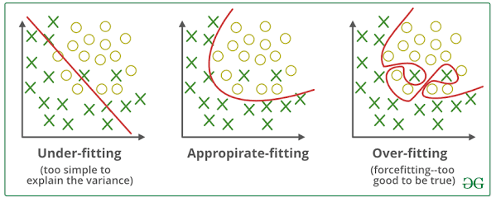
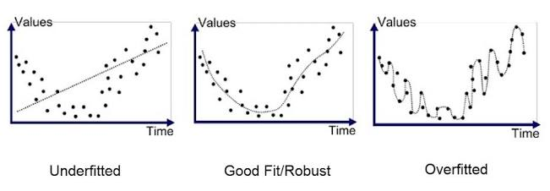
Cont..
Examples of under fit , Balanced / Good/ Robust / Appropriate fit, over fit

Slide 20
Cont..
Bias – Variance Trade off
The error in learning can be of two types
Errors due to ‘Bias’
Arise from simplifying assumptions made by model – less complex / easier to learn
Due to underfitting – high bias
Parametric models – having high bias make easier to understand/interpret and faster to learn – results in errors
[best zero bias – not feasible]
Errors due to ‘Variance’
Occur from difference in training data sets used to train
Ideally – difference in datasets should not be significant and different sets should not be too different
Due to over fitting
Even a small difference in training data gets magnified

Slide 21
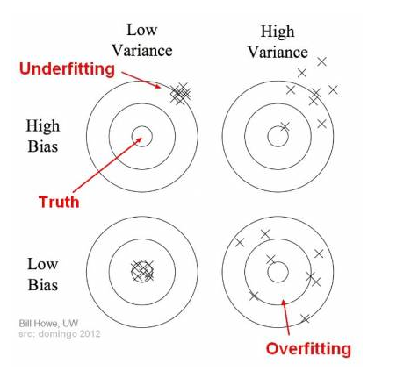
Cont..

Slide 22
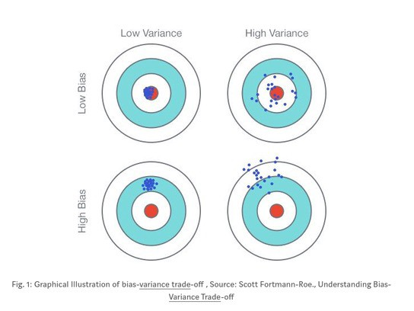
Cont..

Slide 23
EVALUATING PERFORMANCE OF A MODEL
Supervised learning - Classification
To evaluate the performance of model – number of correct classifications / predictions – to be recorded
Classification is correct – it has been predicted by the model the right value
Eg – predicting cricket match win / loss ; if model predicts win and match won then classification is correct
accuracy of the model is calculated - Based on number of correct and incorrect –
Out of 100 , 99 times correct - 99% correct
Might be ok if cricket match ; but not for critical illness problems
Look out for other measures – sensitivity, specificity, precision etc – currently accuracy next slides

Slide 24
Cont..
With cricket example
WIN IS CLASS OF INTEREST - then
Model predicted win and team won
TRUE POSITIVE – TP CASES
Model predicted win and team Lost
FALSE POSITIVE – FP CASES
Model predicted lost and team won
FALSE NEGATIVE – FN CASES
Model predicted lost and team lost
TRUE NEGATIVE – TN CASES

Slide 25
Cont..
Actual Outcome
WIN
LOSS
WIN
Predicted Outcome
TRUE POSITIVE
FALSE POSITIVE
LOSS
FALSE NEGATIVE
TRUE NEGAITIVE

Slide 26
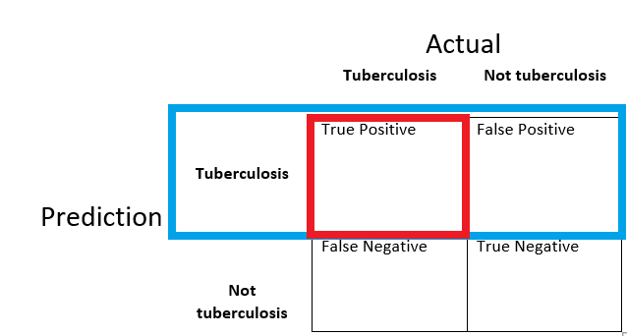
Cont..

Slide 27
Cont..
MODEL ACCURACY – Given by number of correct classifications divided by total number of classifications done
Model Accuracy =
Model accuracy = (85 + 9)/(85+2+4+9) = 94/100 = 94%
CONFUSION MATRIX – matrix containing correct and incorrect predictions in form of TPs, FPs, FNs & TNs
TP + TN
TP + FP + FN + TN
 | ACTUAL WIN | ACTUAL LOSS
PREDICTED WIN | 85 | 4
PREDICTED LOSS | 2 | 9

Slide 28
Cont..
The percentage of misclassifications is indicated using error rate
Error Rate =
In the context of above confusion matrix,
Error rate = (4+2)/(85+2+4+9) = 06/100
= 06%
= 1 – Model Accuracy
FP + FN
TP + FP + FN + TN

Slide 29
Cont..
Sometimes – TPs and TNs – maybe coincidence
Kappa Value adjusts the model accuracy
Kappa Value(k)=
Where P(a)= proportion of observed agreement between actual and predicted in overall data set
=
P(P_{r}) = Proportion of expected agreement between actual and predicted data both in case of class of interest as well as the other classes
=
P(a) – P(p_{r})
1 – P(p_{r})
TP + TN
TP + FP + FN + TN
TP + FP
TP + FN
FN + TN
FP + TN
X
+
X
TP + FP + FN + TN
TP + FP + FN + TN
TP + FP + FN + TN
TP + FP + FN + TN

Slide 30
Cont..
From the above confusion Matrix
Calculate
P(a) = 0.94
P(Pr) = 0.7866
k = 0.7162
Kappa Value can be 1 at maximum, which represents perfect agreement between model’s prediction and actual values

Slide 31
Cont..
Some tasks like – prediction of tumor – if tumor is malignant and wrongly classified as not creates problem;
if higher no of tumors which are benign are wrongly classified as malignant is not a matter
Two such critical measurements - Sensitivity and Specificity
SENSITIVITY – of a model measures the proportion of TP examples which were correctly classified =
For above =97.7;
SPECIFICITY – indicates a good balance of model being excessively conservative or excessively aggressive – negative examples which are classified = 69.2%
; higher the better
TP
TP + FN
TN
TN + FP

Slide 32
Cont..
Two other performance measures of a supervised learning model which are similar to sensitivity and specificity
PRECISION & RECALL
Precision – gives the proportion of positive prediction which are truly positive
Model with higher precision is perceived to be more reliable
= 95.5%
Recall – proportion of TP cases over all actually positive cases
= 97.7%
TP
TP + FP
TP
TP + FN

Slide 33
F- measure
Cont..
F-measure – another measure of model performance which combines the precision and recall
Harmonic mean of precision and recall – as below
= (2 * 0.955 * 9.77) / (0.955 * 9.77) = 96.6%
2 X precision X recall
F-measure =
Precision + recall

Slide 34
ROC curves – Receiver operating characteristic
Visualizing performance of classification model
The ROC curve is created by plotting the true positive rate (TPR) against the false positive rate (FPR) at various threshold settings.
TPR - sensitivity, recall or probability of detection - ML
FPR - fall-out or probability of false alarm - (1 − specificity)
TP
TPR =
TP + FN
FP
FPR =
FP + TN

Slide 35
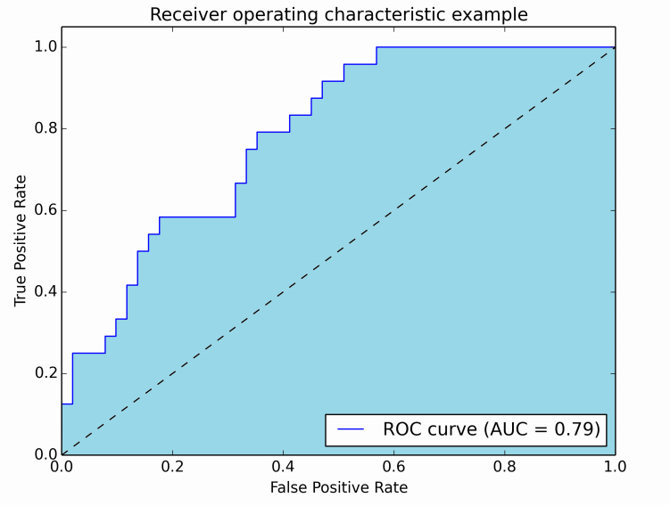
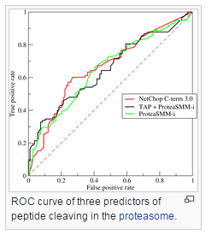
Cont..
AUC stands for "Area under the ROC Curve.“
AUC provides an aggregate measure of performance across all possible classification thresholds.
AUC – value ranges from 0 to 1 ; less than 0.5 classifier has no predictive ability
Indicative interpretations
0.5 – 0.6 -> Almost no predictive ability
0.6 – 0.7 -> Weak Predictive ability
0.7 – 0.8 -> Fair predictive ability
0.8 – 0.9 -> Good predictive ability
0.9 – 1.0 -> Excellent predictive ability
Can plot the curves of more than one classifier
Eg. – 3 classifiers – drawn 3 curves
AUC of each classifier is verified with others
Inference can be drawn
Area below … line – classifier with no predictive values

Slide 36
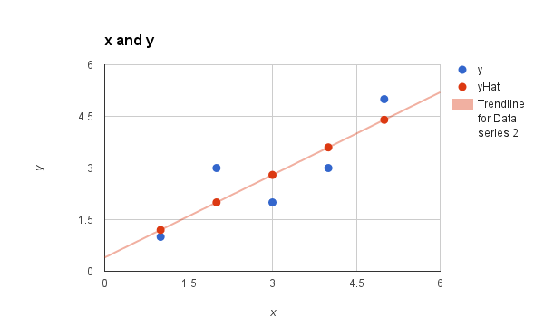
Supervised learning - Regression
Well-fitted regression model – predicted values close to actual values
Linear regression model – predictor varaible (x) ; value is target variable (y) – model representation
y = mx + c
y is the actual value
^
yhat or y - predicted value
Error is the measurement
Between – residual - >
y and yhat

Slide 37
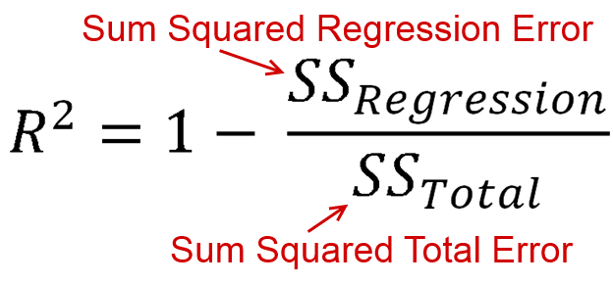
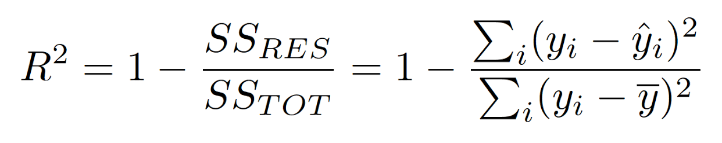
Regression model – fitted well if residual value is less
R- squared – good measure to evaluate model fitness – known as coefficient of determination
Values lies between 0 to 1 (0% - 100%) – large value – better fit
Calculated as
Where y Is the mean

Slide 38
Unsupervised learning - Clustering
Try to reveal natural grouping amongst the data sets
Tricky to evaluate the performance
‘Clustering is in the eye of the beholder’
Two challenges
Not known how many clusters can be formulated from particular data set. Completely open-ended in most cases ; provided as a user input
Even if no of clusters is given, same number of clusters can be formed with different groups of data instances
Successful if the clusters identified using the algorithm is able to achieve the right results in the overall problem domain
Eg customer segmentation in marketing campaign – successful if the marketing campaign ends with a success

Slide 39
Internal evaluation
Based on the underlying data that was clustered.
Measures cluster quality based on
homogeneity of data belonging to the same cluster and
heterogeneity of data belonging to different clusters
Silhouette Coefficient
most popular internal evaluation methods, uses distance (Euclidean or Manhattan distances)
Silhouette width = (b(i) – a(i)) / max{a(i), b(i)}
Where
a(i) – average of distances a_{i1},a_{i2}…a_{in} of the different data elements from the ith data element in cluster 1
- n1 data elements in cluster 1
a(i) = (a_{i1} + a_{i2} +… +a_{in}) / n₁

Slide 40
Calculation of b(i) example –
if data element ‘I’ in cluster 1 with different data element in cluster ‘4’ then -
b₁₄(average) – (b₁₄ (1)+ b₁₄ (2)……+b₁₄ (n₄)) / n₄
- n₄ data elements in cluster 4
b(i) = mimimum(b₁₂(average), b₁₃(average), b₁₄(average))

Slide 41
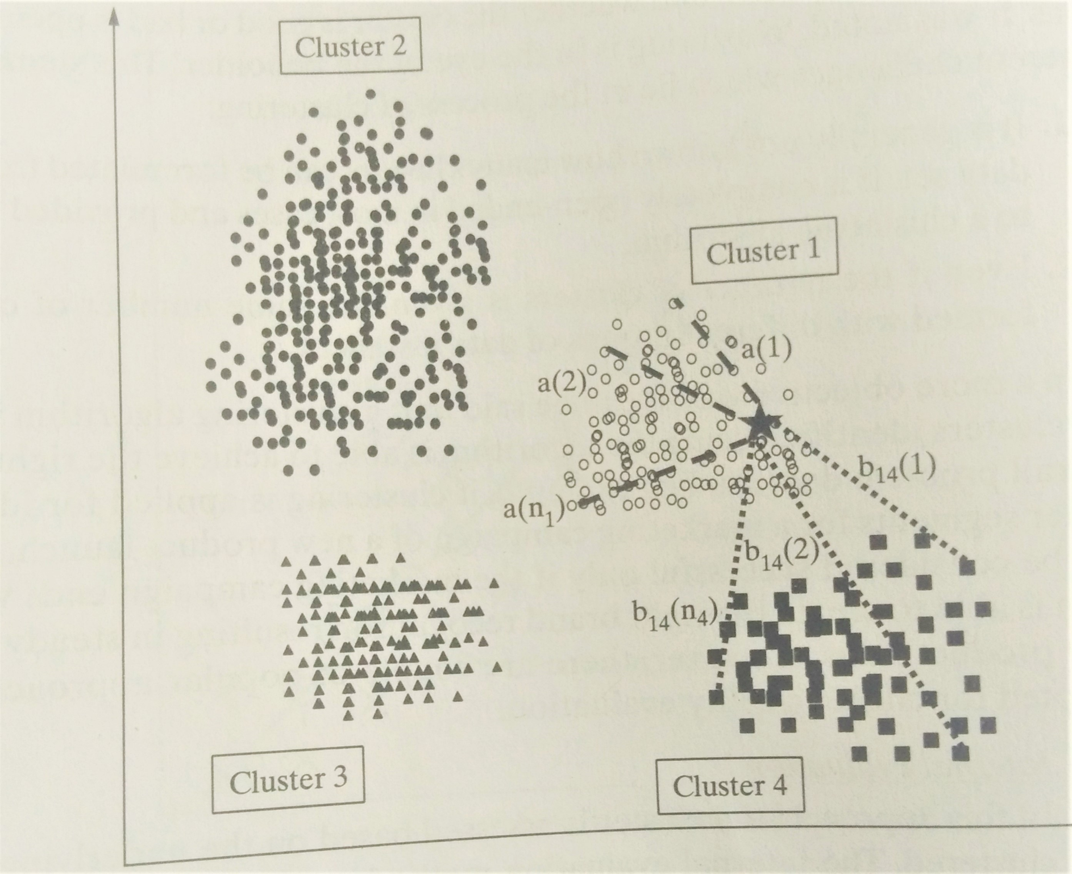

Slide 42
External evaluation
Based on how close the results are compared to those known class labels
Purity – most popular measure of cluster algorithms
Evaluates the extent to which clusters contain a single class
For a data set having ‘n’ data instances and ‘c’ known class lables – generates ‘k’ clusters, purity is measured as :
Purity = 1/n ∑ max (k ꓵ c)

Slide 43
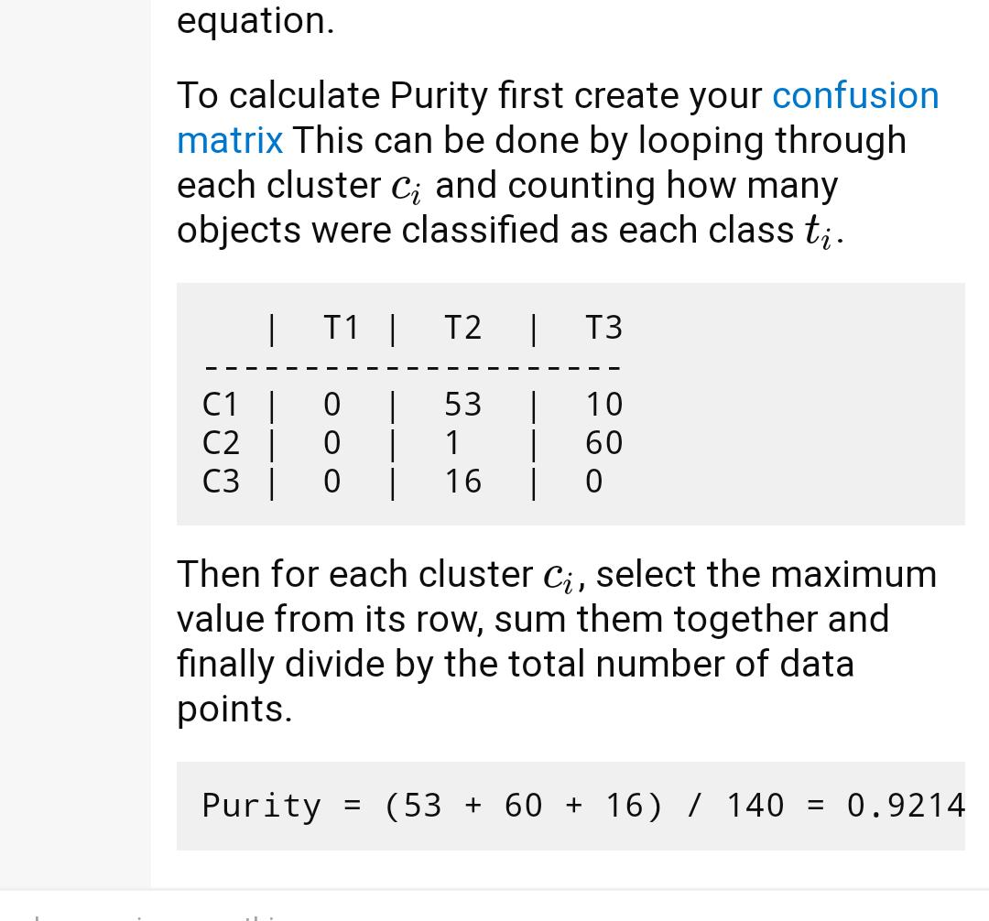

Slide 44
IMPROVING PERFORMANCE OF A MODEL
Can we improve performance of model
What levers for improving the performance?
Which model should be selected for which ML task
Some discussions
Type of learning the task in hand – supervised or unsupervised
Type of data, i.e numeric or categorical
Sometimes on the problem domain
Experience in working with different models to solve problems of diverse domains

Slide 45
Ways to improve model performance
By tuning model parameter
Process of adjusting the model fitting options
Most ML models will have at least one model that can be tuned
Eg – kNN (k Nearest Neighbor) model – use different values of k – number of nearest neighbors – tune the model
No of hidden layers in neural networks model
Ensemble – combining different models with diverse strength
Helps in averaging out biases and reducing variance
Steps
Build a number of models based on training data
Sampling techniques may be used to generate unique data sets
Same datasets can be used bur the models combined are varying
Outputs from different models are combined using a combination function

Slide 46
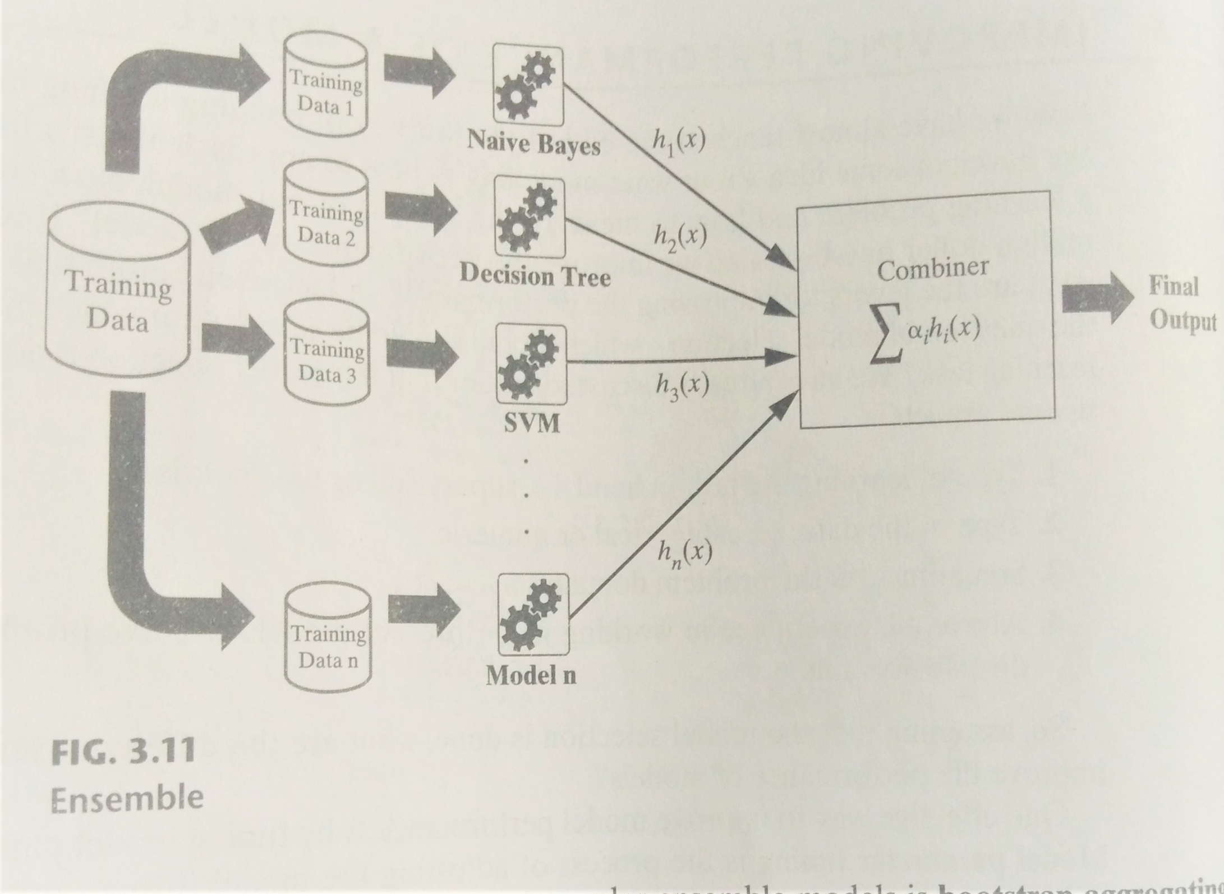

Slide 47
Ensemble methods
Bootstrap aggregation or bagging
Uses bootstrap sampling to generate multiple training sets
Train a set of modes using the same learning algo
Outcomes of the models are combined – voting or average
Very simple – can perform well for unstable learners like decision tree where slight change in data large impact
Boosting
Weaker training models are trained or resampled data and out comes are combined based on performance of different modes
Based on idea of generating weak and slowly learning
Random forest – ensemble of decision trees – hence name random forest

Slide 48
FEATURE ENGINEERING

Slide 49
Feature – attribute of data in ML
Data set having n features - n-dimensional data set
Unstructured data – raw, unorganized – eg text data – twitter ,facebook
Feature engineering – Process of a data set into features such that – represent the data set more effectively – resulting in better performance
Two major elements
Feature Transformation
Feature Subset Selection

Slide 50
Feature Transformation
Transforms the data -structured / unstructured into a new set – represents the underlying problem which ML is trying to solve
Eg – text categorization - spam/ not spam – can’t let the model identify and have all data set as training features – can represent doc with bag of words
Effective tool for dimensionality reduction and boosting ML performance
Two goals
Achieving best reconstruction of the original features in the data set
Achieving highest efficiency in the learning task
Two variants
Feature Construction
Feature Extraction

Slide 51
Feature Construction
Transforming a given set of inputs to generate a new set of powerful features
Discovers missing info among the relationships between features and argument vector space creating additional features – if n features are there – after this m might get added – n+m dimensional data set
Eg – data set has 3 features - appt length, breadth, price
Length | Breadth | price
80 | 59 | 23,60,000
54 | 45 | 12,15,000
78 | 56 | 21,84,000
63 | 63 | 19,84,000
Length | Breadth | Area | price
80 | 59 | 4720 | 23,60,000
54 | 45 | 2430 | 12,15,000
78 | 56 | 4368 | 21,84,000
63 | 63 | 3969 | 19,84,000
4 dimensions –
We can exclude the first 2 also
3 dimensions - original

Slide 52
Encoding Categorical (Nominal) variables
City A, City B, City C… - can be encoded as 1,2,3….
Sunny, rainy – is sunny -1, is rainy – 1 ; 0 stands for not sunny/rainy
Encoding Categorical (Ordinal) variables
Eg – need values to work on – say grades – B, C, A, D – can be coded as 2,3,1,4
Transforming numeric (Continuous) values to categorical values
Eg – real estate price perdition(regression) – real estate category prediction (classification problem)
Text Specific Feature Construction
Making sense of text – unstructured data is difficult – not so straightforward – text key words to numerical representation
Three major steps – Tokenize, count, normalize

Slide 53
Feature Extraction
Process of extracting or constructing new set of features from the original set using some functional mapping
Example
For Boolean features – conjunction, disjunction, negation etc
For Nominal features – Cartesian product, M of N etc
For Numeric features - max, min, addition, multiplication, avg, deviation, equivalence, etc.
Popular feature extraction algorithms used -
Principal Component Analysis
Singular value Decomposition
Linear Discriminate Analysis

Slide 54
Principal Component Analysis

Slide 55
Singular value Decomposition

Slide 56
Linear Discriminate Analysis

